Slide 1
Generalizability of Sensor-Free Affect Detection Models
Emily Jensen
Stephen Hutt
Sidney D’Mello
EDM 2019

Slide 2






Notes:
You have probably had the experience of being disappointed with your performance on an exam
Perhaps you found yourself falling in love with the material you were learning
Or you were proud of yourself for getting an experiment to run correctly
Or you were frustrated when said experiment did not replicate

Slide 3




Previous Work
Hutt, Grafsgaard, & D’Mello. Time to Scale: Generalizable Affect Detection for Tens of Thousands of Students across an Entire School year. CHI 2019
Notes:
Building off of previous work, which showed the feasibility of scaling sensor-free affect detection to a state-wide or larger scale
Be clear that we did not actually do the entire country (just Florida)

Slide 4
Notes:
Previously measured performance on the entire population of students and focused on getting higher predictive scores

Slide 5




Notes:
In this work, we shift the focus to consider differential performance on individual groups of students rather than the entire population

Slide 6


Notes:
AN is an online platform for learning algebra. Used in classes or at home, hundreds of thousands of students use it.

Slide 7
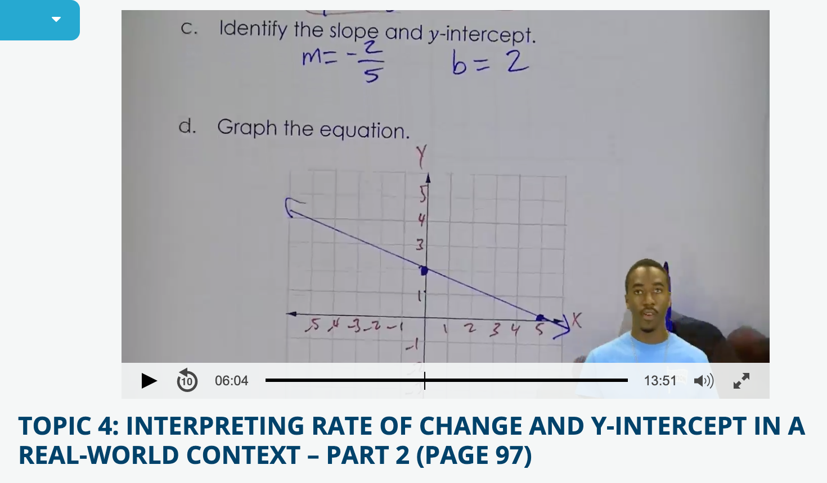
Algebra Nation
Notes:
Students can watch videos from expert tutors

Slide 8
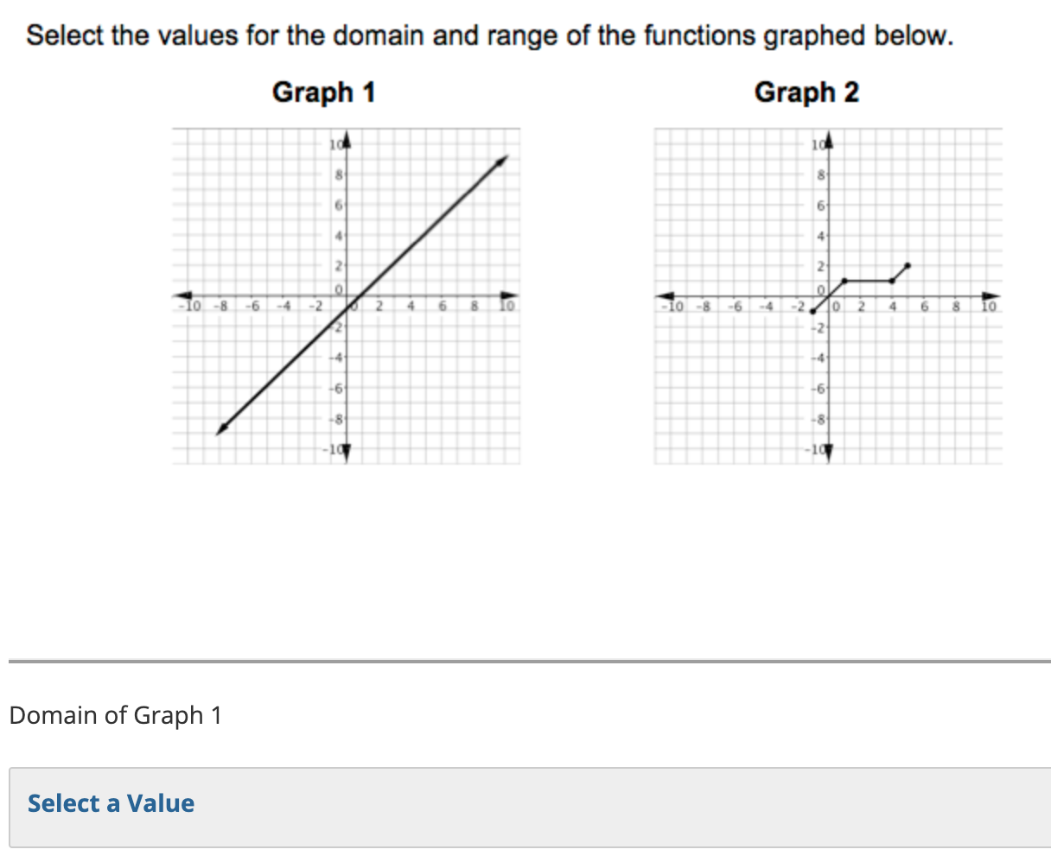
Algebra Nation
Notes:
They can take quizzes that have multiple choice and free response questions to test their knowledge. Some teachers may assign this as a homework assignment

Slide 9
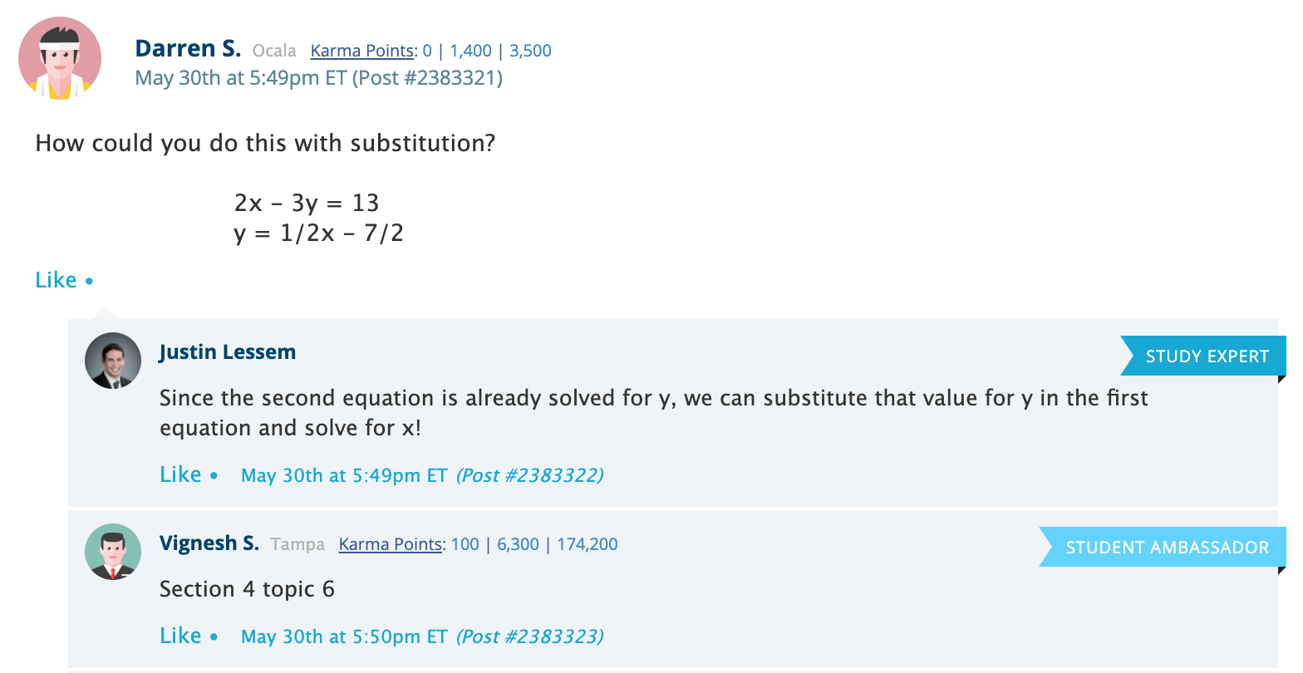
Algebra Nation
Notes:
Students can post questions they are stuck on to get help from other students or the study expert on duty

Slide 10




Usage Clusters
Primary
Semester
Logins &
Length
Primary
Device
Notes:
Identified 5 typical usage profiles based on primary semester, amount of usage, and primary device
This is calculated using their data for the entire school year
Note that the clusters do not have even sizes
Details on how clustering was done can be found in the paper

Slide 11





Demographic Clusters
Race &
Ethnicity
Lunch
Status
Grade
Level
Notes:
Also identified seven clusters based on demographic features
Provided by the Florida DoE

Slide 12
Data
69,174 students
labels
Affect Responses
Notes:
Ground truth labels for the models are based on affect responses

Slide 13
Affective States
Hopefulness
Contentment
Curiosity
Relief
Boredom
Confusion
Arousal
Pride
Frustration
Interest
Mind Wandering
Engagement
Sadness
Happiness
Anxiety
Pleasantness
Surprise
Disappointment
Notes:
Started with 18 affective states of interest

Slide 14
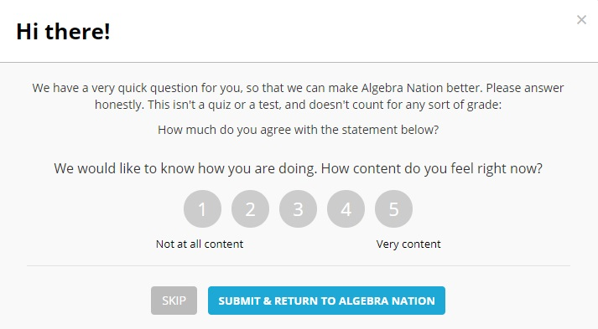
Student Surveys
Notes:
Ground truth from surveys
Surveys are probabilistically triggered based on certain actions
Once a survey has been triggered, won’t see another one for 2 weeks
We are predicting their response on a scale of 1-5

Slide 15


Affective States
Hopefulness
Contentment
Relief
Boredom
Arousal
Confusion
Pride
Frustration
Interest
Mind Wandering
Engagement
Happiness
Sadness
Pleasantness
Anxiety
Disappointment
Notes:
Grouped into positive and negative categories to simplify the models

Slide 16

Data
69,174 students
features
labels
Interaction Click Data
Affect Responses
Notes:
The features for our models are based on sensor-free interaction click data

Slide 17





Instance Building
5 minutes
Survey #1
Survey ID | Play | Pause | Rewind | Forward | Quiz | Post
1 | 3 | 1 | 1 | 0 | 2 | 1
Notes:
When a student answers a survey, count the activities in a 5-minute window preceding the survey.

Slide 18
Model Building
Models for positive and negative states
Bayesian Ridge Regression
10-fold student-level cross validation
Results are:
Evaluated using Spearman correlation
Averaged across folds

Slide 19
Generalizability
Train
Test
Notes:
Train on one group, test on the other groups and the entire population
For example, train on fall mobile group and test on spring heavy use group

Slide 20
Generalizability
Train
Test
Notes:
Train on one group, test on the other groups and the entire population

Slide 21
Generalizability
Train
Test
Notes:
Train on one group, test on the other groups and the entire population

Slide 22
Generalizability
Train
Test
Notes:
Train on one group, test on the other groups and the entire population

Slide 23
Generalizability
Train
Test
Notes:
Train on one group, test on the other groups and the entire population

Slide 24
Generalizability
Train
Test
Notes:
Repeat this process for each group

Slide 25
Generalizability - Usage
Test → Train ↓ | Spring, heavy | Spring, light | Fall, light | Fall, mobile | Spring, mobile | All
Spring, heavy | 0.25 (0.19) | 0.23 (0.22) | 0.21 (0.19) | 0.19 (0.19) | 0.21 (0.18) | 0.21 (0.20)
Spring, light | 0.21 (0.18) | 0.26 (0.23) | 0.22 (0.19) | 0.21 (0.20) | 0.22 (0.19) | 0.22 (0.20)
Fall, light | 0.21 (0.17) | 0.24 (0.21) | 0.23 (0.20) | 0.20 (0.19) | 0.20 (0.17) | 0.22 (0.19)
Fall, mobile | 0.20 (0.17) | 0.25 (0.22) | 0.21 (0.19) | 0.21 (0.20) | 0.21 (0.19) | 0.22 (0.21)
Spring, mobile | 0.23 (0.17) | 0.25 (0.22) | 0.21 (0.18) | 0.20 (0.19) | 0.24 (0.21) | 0.22 (0.20)
All | 0.22 (0.18) | 0.25 (0.22) | 0.22 (0.20) | 0.21 (0.20) | 0.22 (0.19) | 0.22 (0.21)
Models perform similarly well across groups
Notes:
This is a table that cross training creates (common in previous work)
Negative models in parentheses
Want to see that a model trained on one group performs generally well across other groups (across the row)
We found similar results for models trained on the demographics clusters as well

Slide 26
Individual Advantage
Train
Test
Train
Test
All
Train
Test
All
Notes:
This is our metric to evaluate the cross-training shown in the previous slides
Improvement over using a general model for a target group
Mean advantage is pretty low, considering any interventions we may take are low stakes.

Slide 27
Individual Advantage
Train
Test
Train
Test
Mean advantage
4%
All
Train
Test
All
Notes:
This is our metric to evaluate the cross-training shown in the previous slides
If perfectly generalizable, expect a score of 0
Improvement over using a general model for a target group
Mean advantage is pretty low, considering any interventions we may take are low stakes.

Slide 28
Sample Size Simulations
Does more data lead to better generalizability?
Notes:
We are challenging the concept of “more data is better”

Slide 29
Sample Size Simulations
1000x
Randomly sample 500 instances
Train model and calculate metric
Average score over 1000 iterations

Slide 30
Sample Size Simulations
1000x
Randomly sample 700 instances
Train model and calculate metric
Average score over 1000 iterations

Slide 31
Sample Size Simulations
1000x
Randomly sample 900 instances
Train model and calculate metric
Average score over 1000 iterations

Slide 32
Sample Size Simulations
1000x
Randomly sample n instances
Train model and calculate metric
Average score over 1000 iterations
Notes:
Keep doing this until you reach the size of the cluster

Slide 33
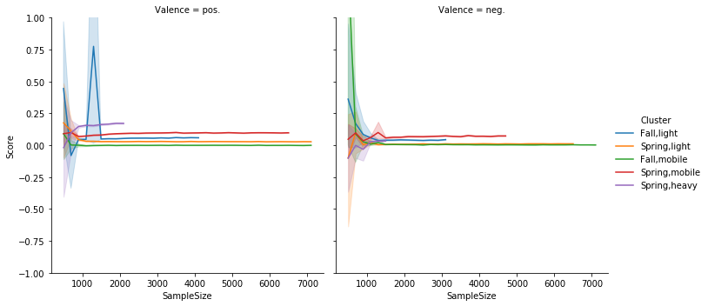
Sample Size Simulations
Notes:
Unstable predictions under 1,500 samples, stable predictions afterwards but no improvement in generalizability
95% confidence interval is plotted
This challenges the “more data is better” claim

Slide 34
Sample Size Simulations
Upper bound of 10% individual advantage
Notes:
Unstable predictions under 1,500 samples, stable predictions afterwards but no improvement in generalizability
95% confidence interval is plotted
This challenges the “more data is better” claim

Slide 35
Key Takeaways
We can group students by their long-term usage characteristics
There is a small advantage to train group-specific affect detection models
Models stabilize with more data
Generalizability does not improve with more data

Slide 36





Thank you!
emily.jensen@colorado.edu

Slide 37
Data Details
2017/18 school year
69,174 students (who answered 1+ surveys)
1,898 Florida schools
Mean = 1.94 surveys per student
22 interaction features for 5-min window before survey

Slide 38
Usage Clusters
ID | Cluster Description | Session Time (min) | Num. Sessions | Prop. Spring Use | Prop. Desktop Use | Time of Day (hour) | Prop. of Users
U1 | Spring semester, heavy use | 45.46 | 25.44 | 0.75 | 0.90 | 14.19 | 0.20
U2 | Spring semester, light use | 14.26 | 3.53 | 0.96 | 0.99 | 14.86 | 0.35
U3 | Fall semester, light use | 13.81 | 3.46 | 0.11 | 0.99 | 14.81 | 0.28
U4 | Fall semester, mobile use | 21.38 | 9.54 | 0.19 | 0.30 | 13.25 | 0.07
U5 | Spring semester, mobile use | 29.66 | 10.95 | 0.93 | 0.27 | 13.21 | 0.10
Notes:
K-means clustering

Slide 39
Demographic Clusters
ID | Cluster Description | Grade 7 | Grade 8 | Grade 9 | Grade 10 | F/R Lunch | White | Black | Asian | Prop. Users
D1 | Split grades, F/R lunch, Black | 0.08 | 0.29 | 0.44 | 0.17 | 0.99 | 0.03 | 1.00 | 0.01 | 0.16
D2 | Grade 7, not F/R lunch, White/Asian | 1.00 | 0.00 | 0.00 | 0.00 | 0.20 | 0.80 | 0.06 | 0.16 | 0.10
D3 | Grade 8, not F/R lunch, White | 0.00 | 0.99 | 0.00 | 0.00 | 0.00 | 0.87 | 0.09 | 0.07 | 0.22
D4 | Grade 8, F/R lunch, White | 0.00 | 1.00 | 0.00 | 0.00 | 1.00 | 0.90 | 0.03 | 0.06 | 0.15
D5 | Grade 9, F/R lunch, White | 0.11 | 0.00 | 0.87 | 0.00 | 1.00 | 0.91 | 0.01 | 0.03 | 0.16
D6 | Grade 9, not F/R lunch, White/Black | 0.00 | 0.00 | 0.99 | 0.00 | 0.04 | 0.81 | 0.16 | 0.04 | 0.16
D7 | Grade 10, split F/R lunch, White/Black | 0.00 | 0.00 | 0.00 | 1.00 | 0.52 | 0.76 | 0.20 | 0.03 | 0.05

Slide 40
Generalizability - Demographics
Test → Train ↓ | F/R, Black | G7, White/ Asian | G8, White | G8, F/R, White | G9, F/R, White | G9, White/ Black | G10 , White/ Black | All
F/R, Black | 0.22 (0.16) | 0.20 (0.19) | 0.27 (0.22) | 0.18 (0.17) | 0.24 (0.19) | 0.16 (0.15) | 0.23 (0.18) | 0.21 (0.18)
G7, White/Asian | 0.20 (0.14) | 0.22 (0.22) | 0.27 (0.23) | 0.20 (0.19) | 0.24 (0.21) | 0.17 (0.18) | 0.24 (0.20) | 0.22 (0.20)
G8, White | 0.21 (0.14) | 0.21 (0.21) | 0.28 (0.24) | 0.19 (0.19) | 0.24 (0.21) | 0.17 (0.19) | 0.24 (0.21) | 0.22 (0.20)
G8, F/R, White | 0.20 (0.14) | 0.21 (0.21) | 0.27 (0.24) | 0.21 (0.20) | 0.24 (0.21) | 0.18 (0.20) | 0.23 (0.21) | 0.22 (0.21)
G9, F/R, White | 0.21 (0.16) | 0.21 (0.21) | 0.28 (0.24) | 0.19 (0.18) | 0.25 (0.21) | 0.17 (0.18) | 0.24 (0.20) | 0.22 (0.20)
G9, White/Black | 0.19 (0.11) | 0.21 (0.20) | 0.26 (0.23) | 0.19 (0.18) | 0.23 (0.20) | 0.19 (0.20) | 0.22 (0.20) | 0.21 (0.20)
G10, White/Black | 0.21 (0.13) | 0.21 (0.20) | 0.28 (0.23) | 0.19 (0.18) | 0.24 (0.20) | 0.17 (0.18) | 0.25 (0.21) | 0.22 (0.20)
All | 0.21 (0.14) | 0.22 (0.21) | 0.28 (0.24) | 0.20 (0.19) | 0.24 (0.21) | 0.18 (0.20) | 0.24 (0.21) | 0.22 (0.21)
Notes:
Similar table for demographic clusters

Slide 41
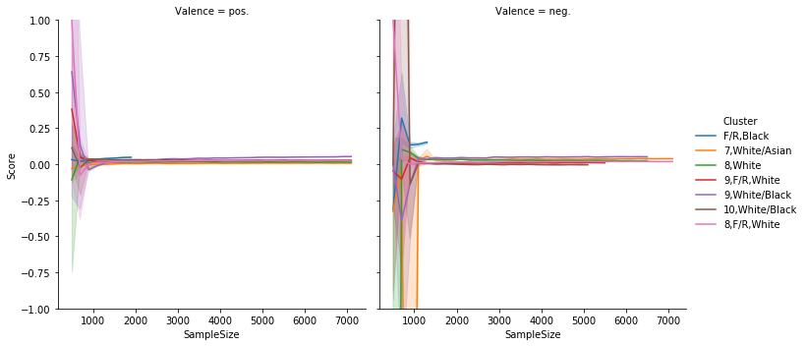
Demographics Simulations

